Slide 1
AI STUDY BUDDY
Team Project - MSc Computer Science
Anika Siddiqui Mayesha – D24125187
Lorenzo Palleschi – D24126922
Rumaysa Babulkhair – D24125711
Yurii Sykal – C23512523

Slide 2

BRIEF WEEKLY OVERVIEW
Logo
Retrospectives
Requirement Specification
Login / Registrations Page
Figma Design Overview
Figma Coded Version

Slide 3



LOGO PROTOTYPE
Feedback received about initial design
Adapted centre to be more fitting for study related service
Bigger companies tend to simplify logos

Slide 4

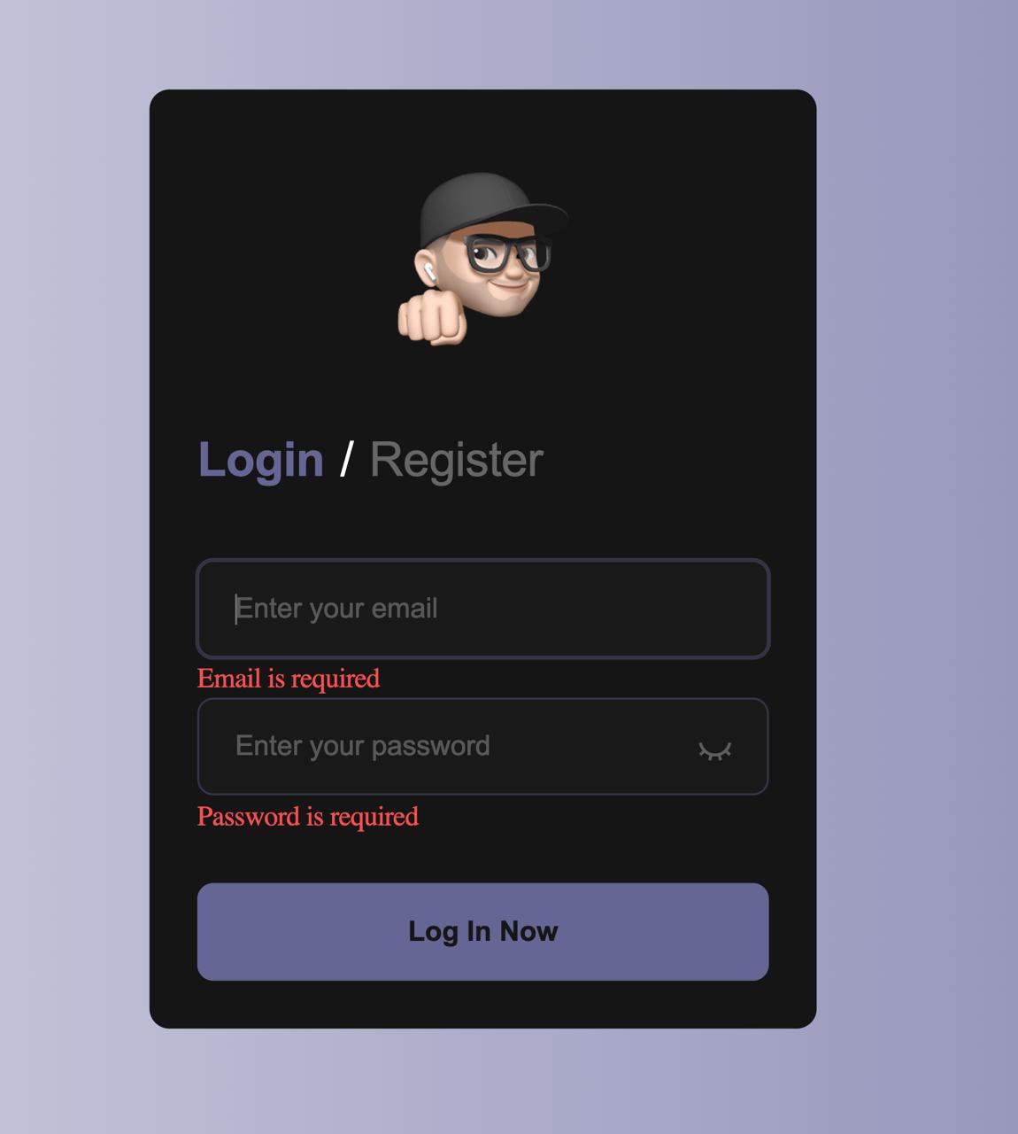
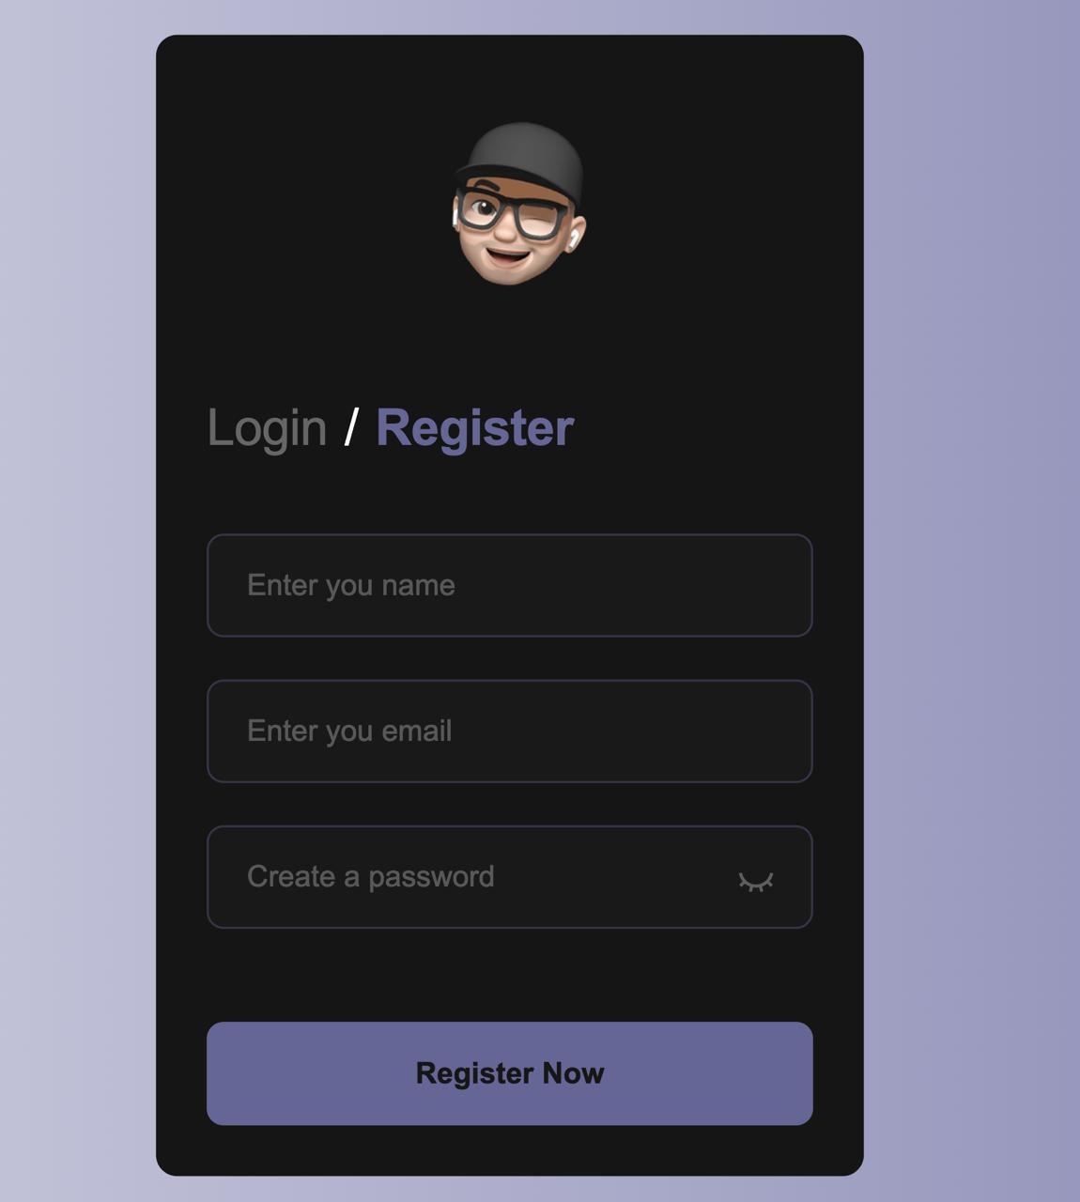
LOGIN/REGISTRATION PAGE
• Initial version (1.0)

Slide 5
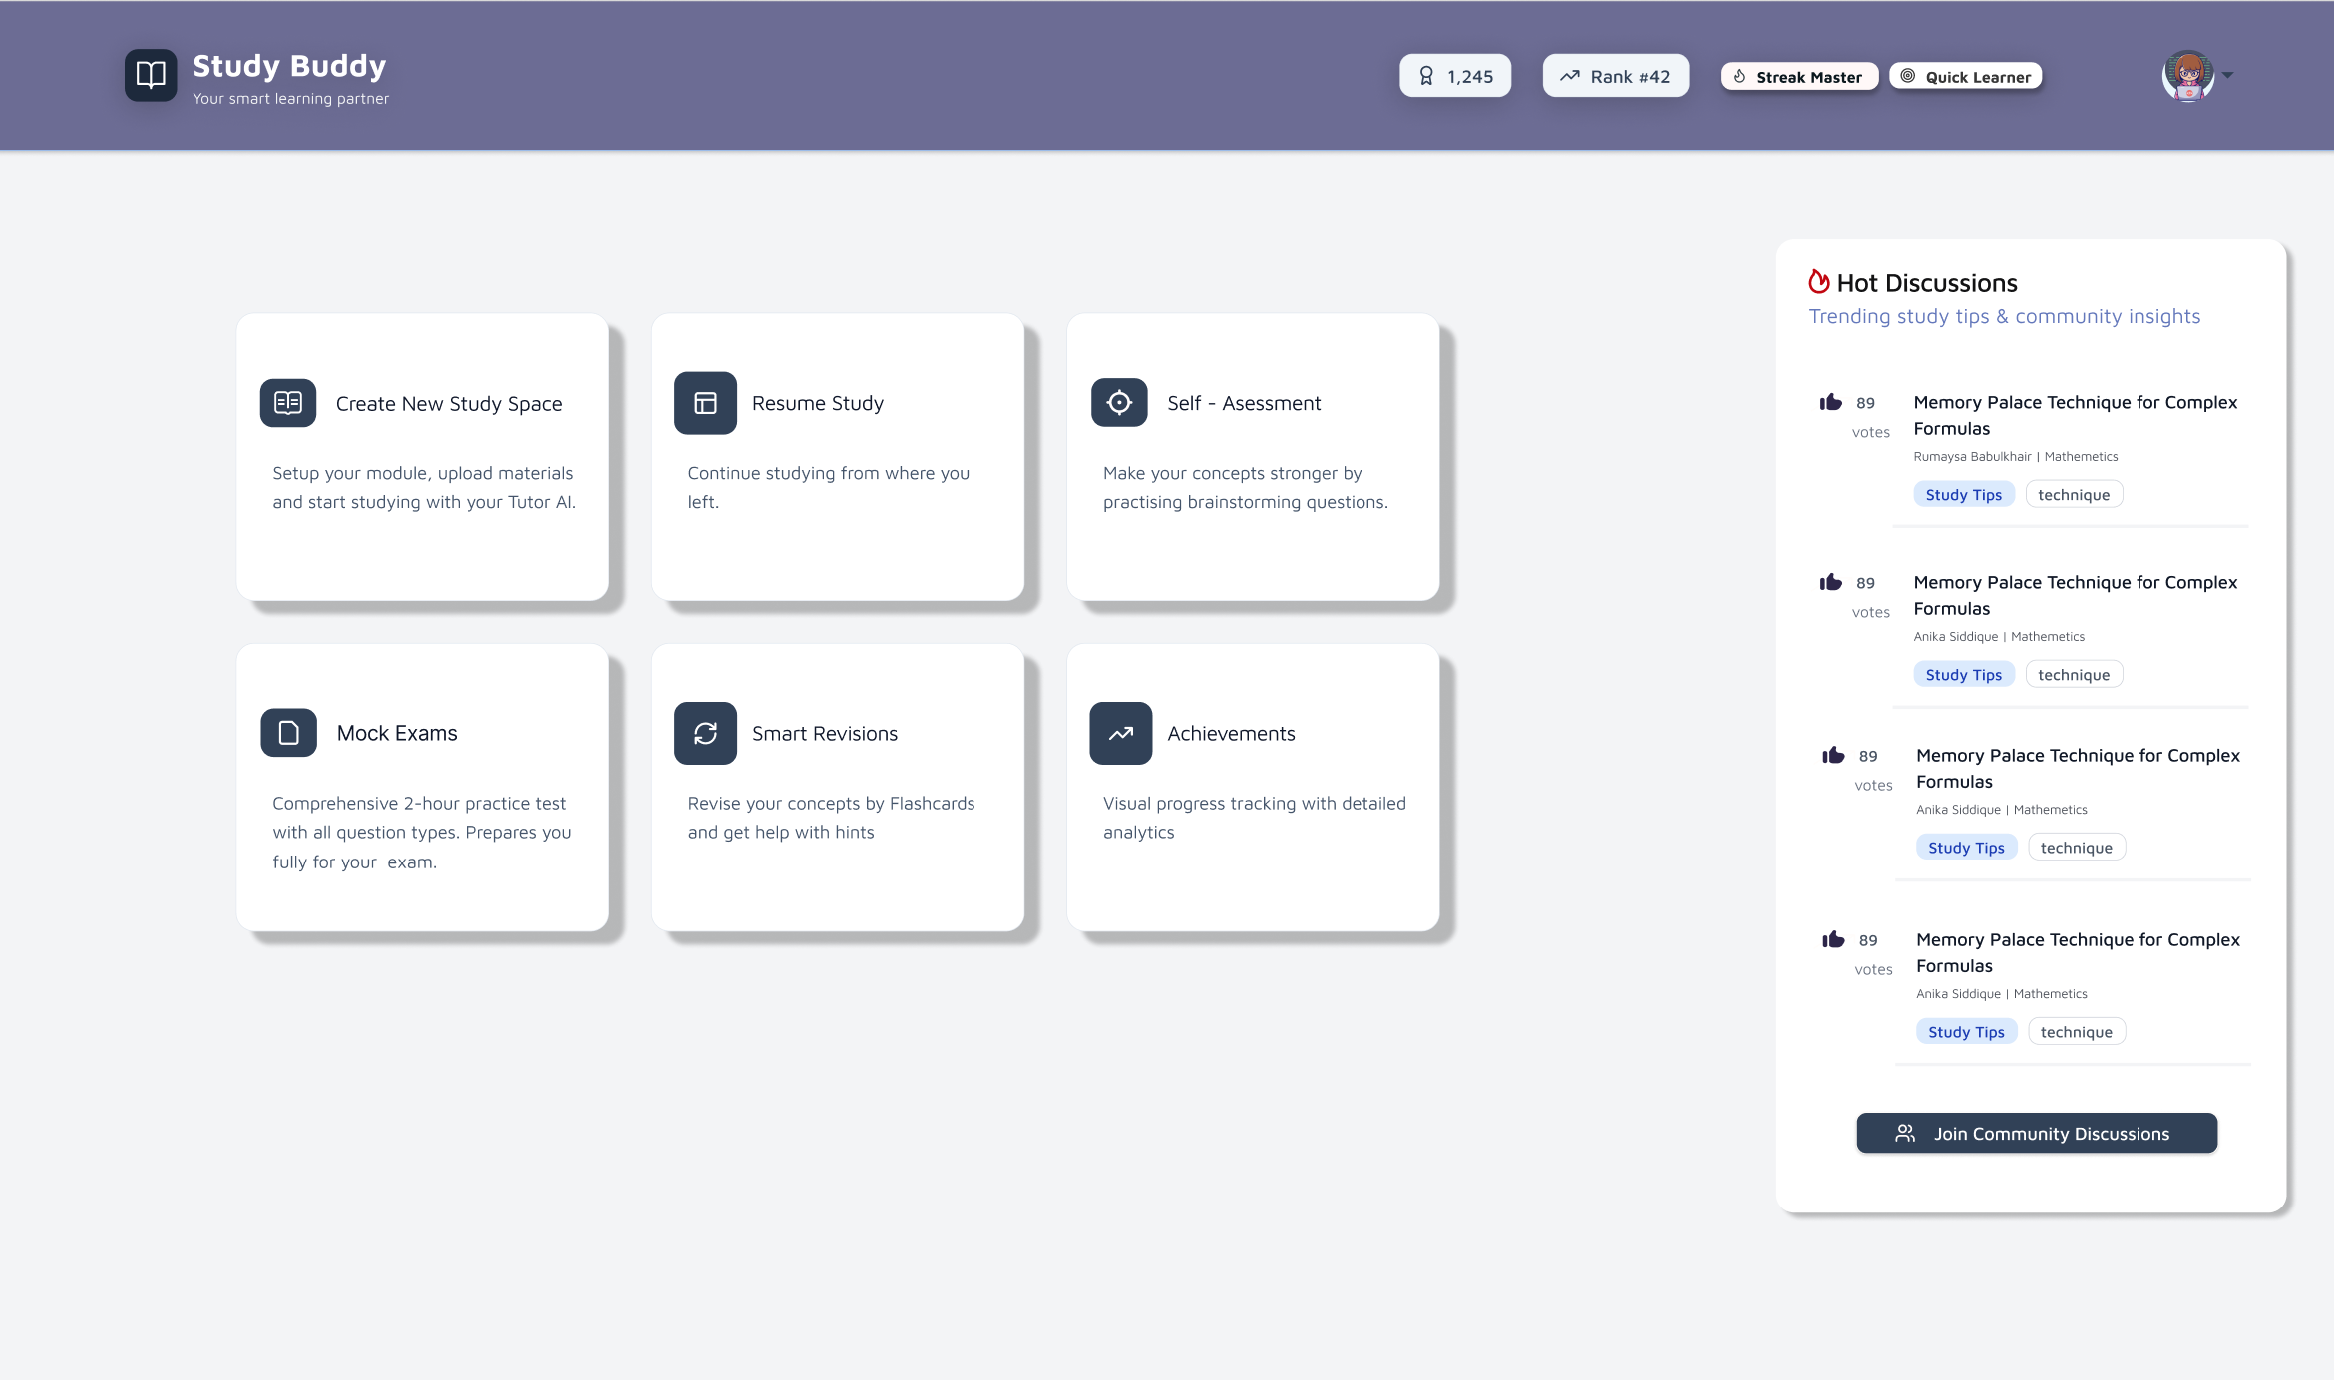
FIGMA DESIGN (DASHBOARD)
Figma design is now updated with a sleeker interface
More neutral colour scheme

Slide 6
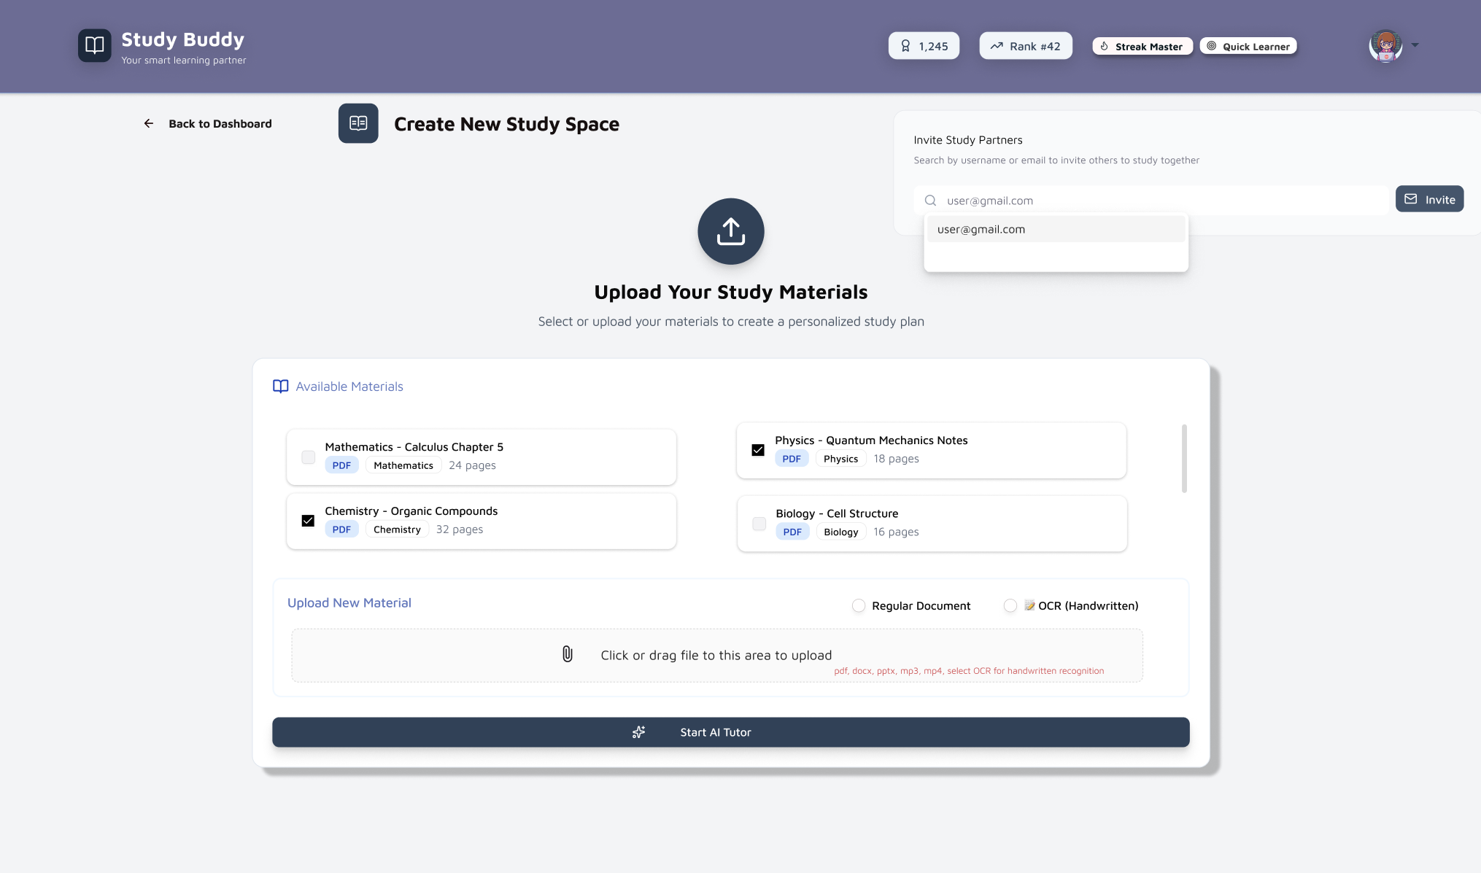
FIGMA DESIGN (STUDY SPACE)
Study materials can be uploaded (various types listed)
Available material can be selected
Study Partners may also be invited

Slide 7
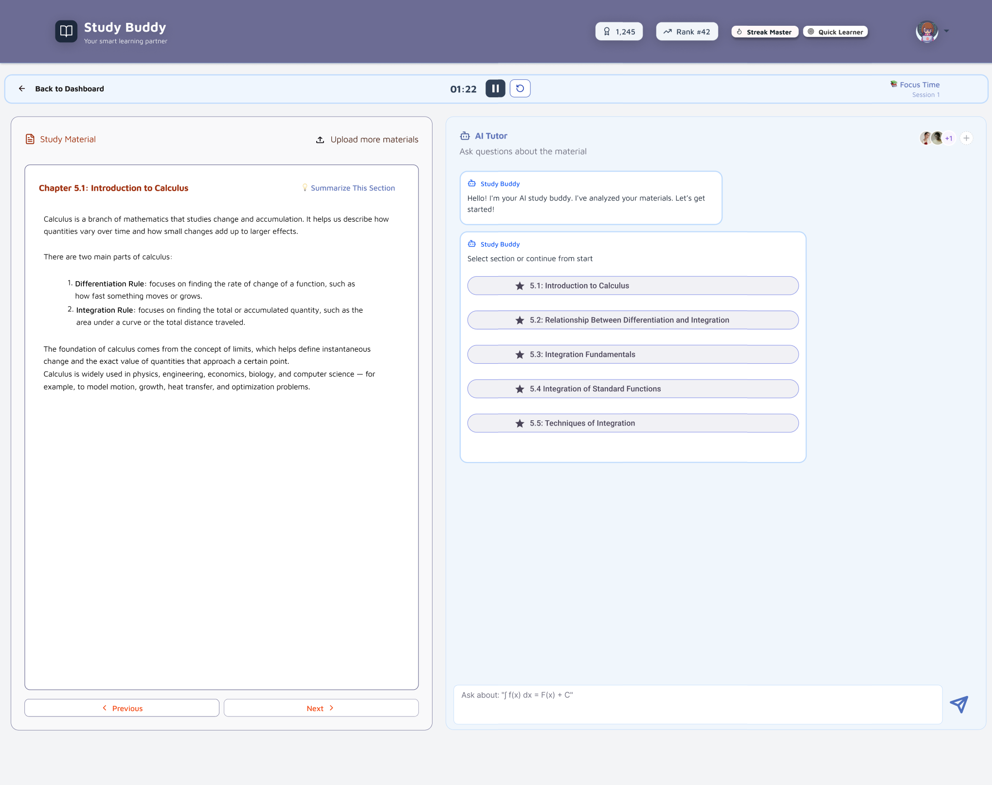
FIGMA DESIGN (AI TUTOR)

Slide 8
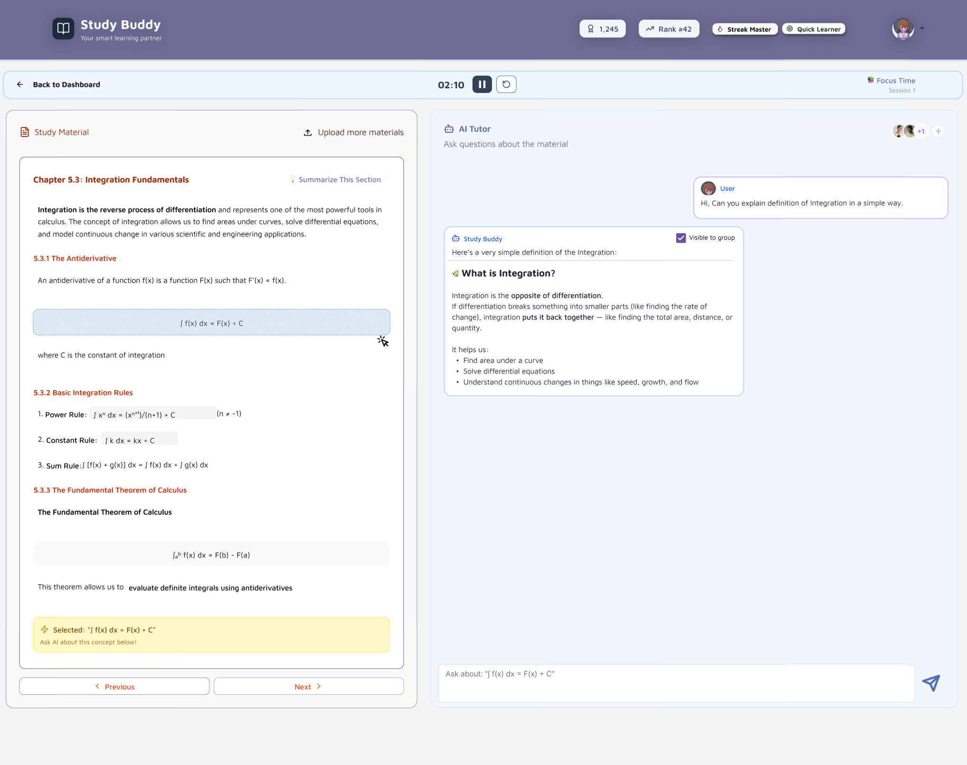
FIGMA DESIGN (AI TUTOR #2)

Slide 9
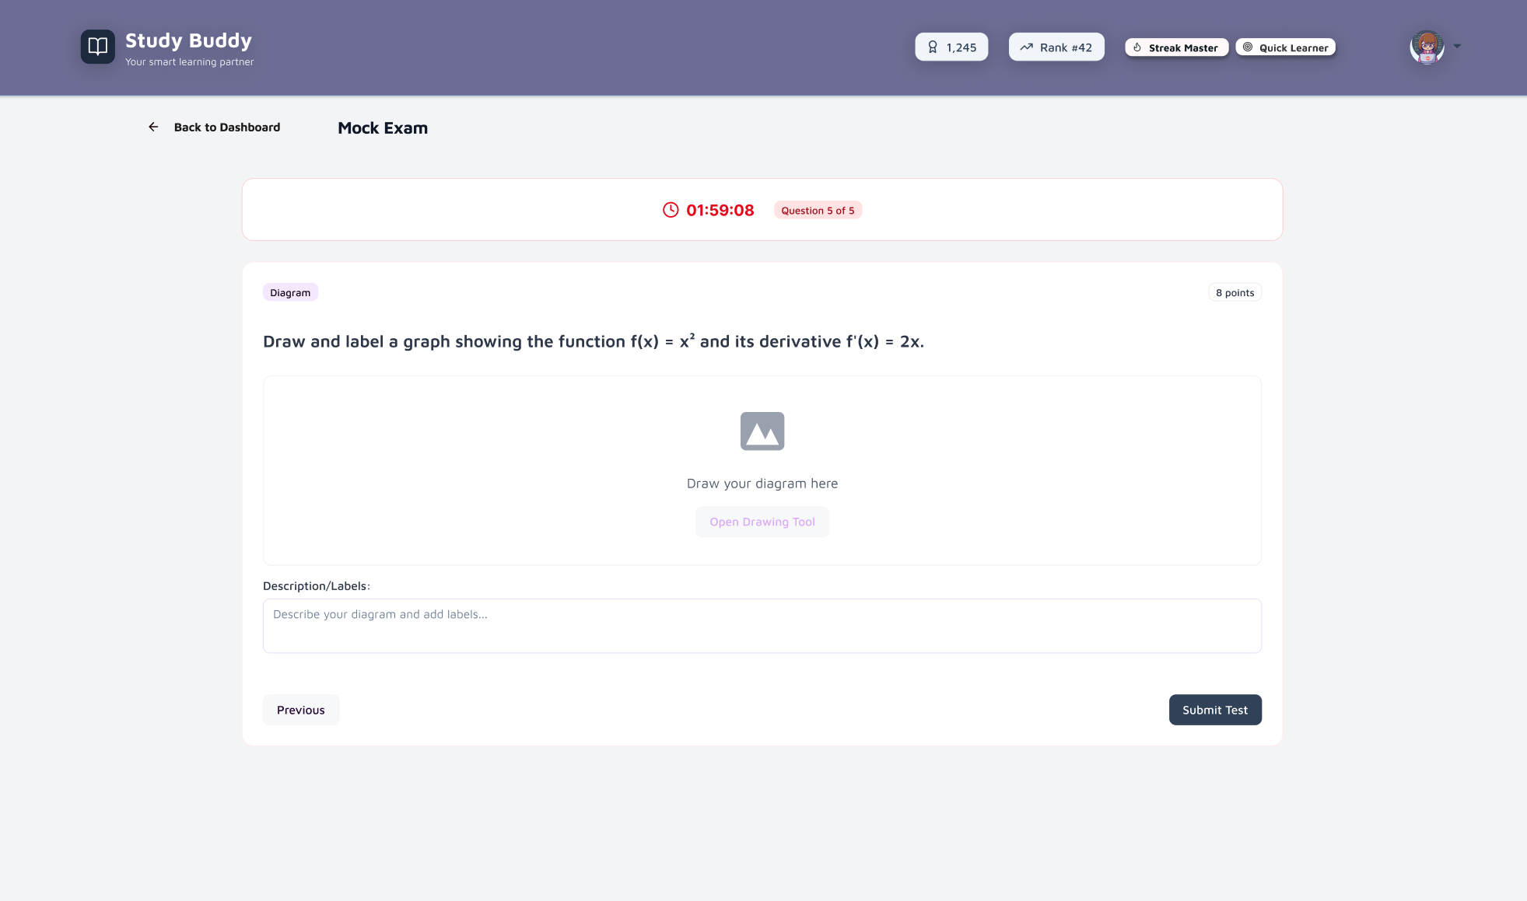
FIGMA DESIGN (MOCK EXAM)

Slide 10
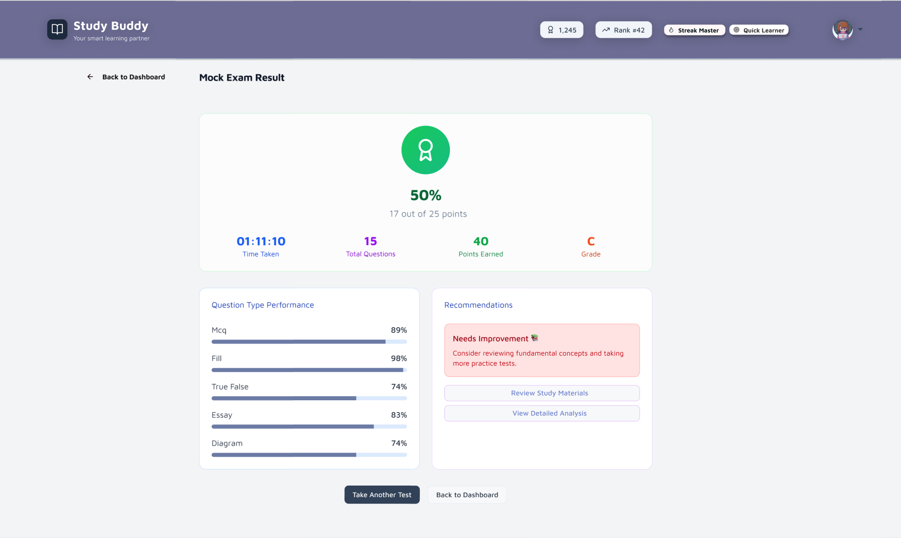
FIGMA DESIGN (MOCK RESULTS)

Slide 11
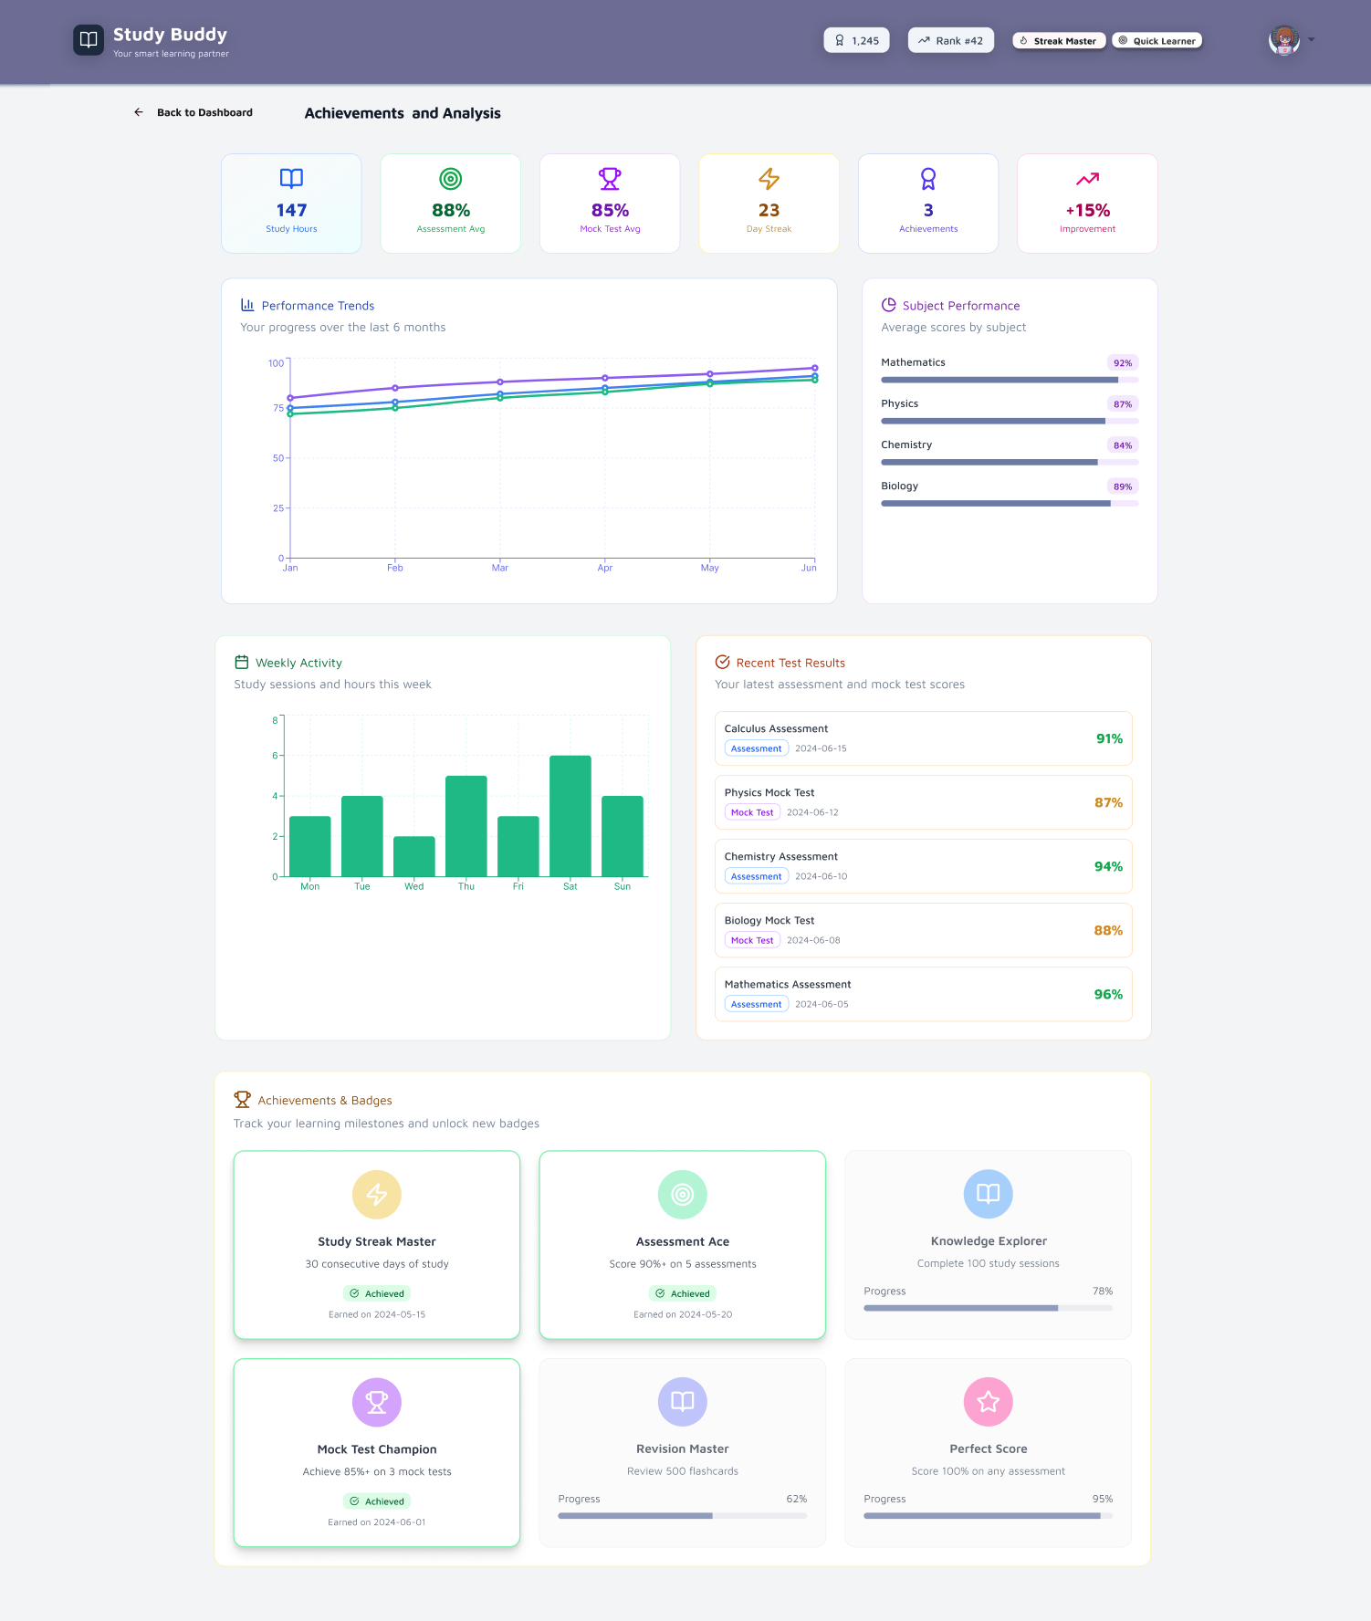
FIGMA DESIGN (ACHIEVEMENTS)

Slide 12
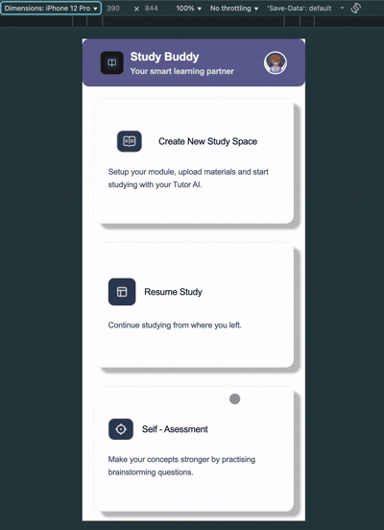
MOBILE PROTOTYPE

Slide 13
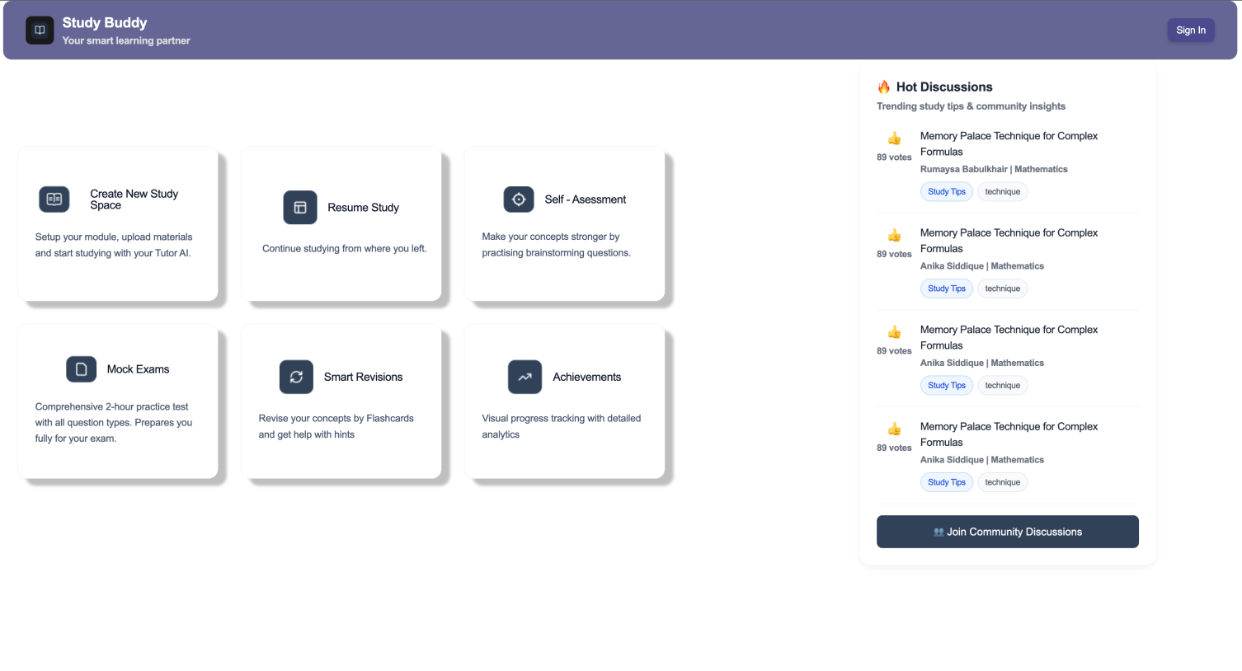
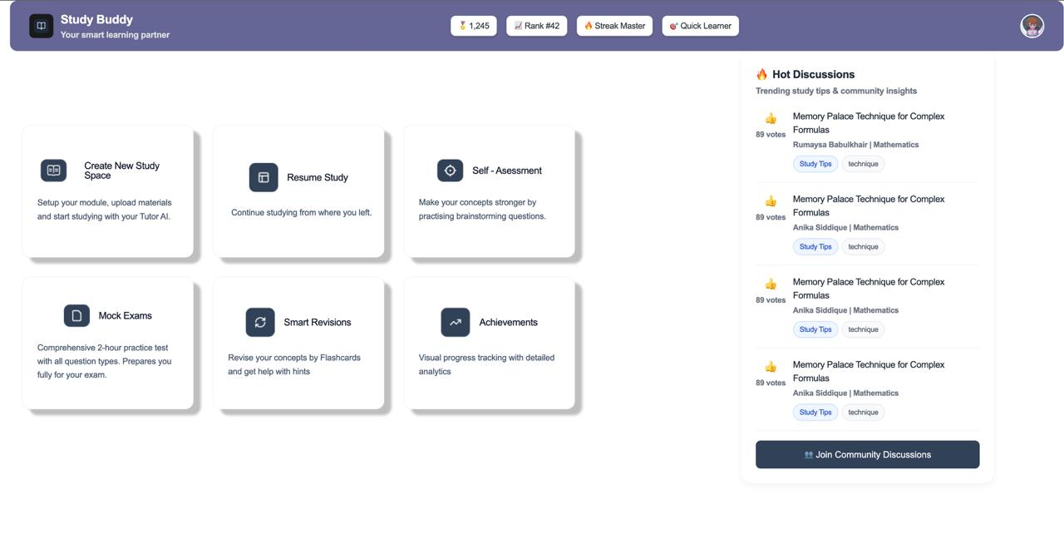
FIGMA TURNED INTO LIVE CODE
Dashboard has been structurally built
Other pages in progress

Slide 14
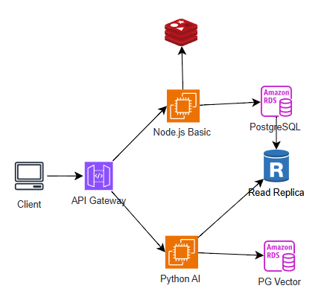
SYSTEM ARCHITECTURE DIAGRAM

Slide 15
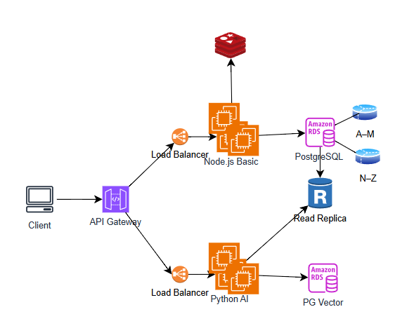
SYSTEM ARCHITECTURE DIAGRAM

Slide 16
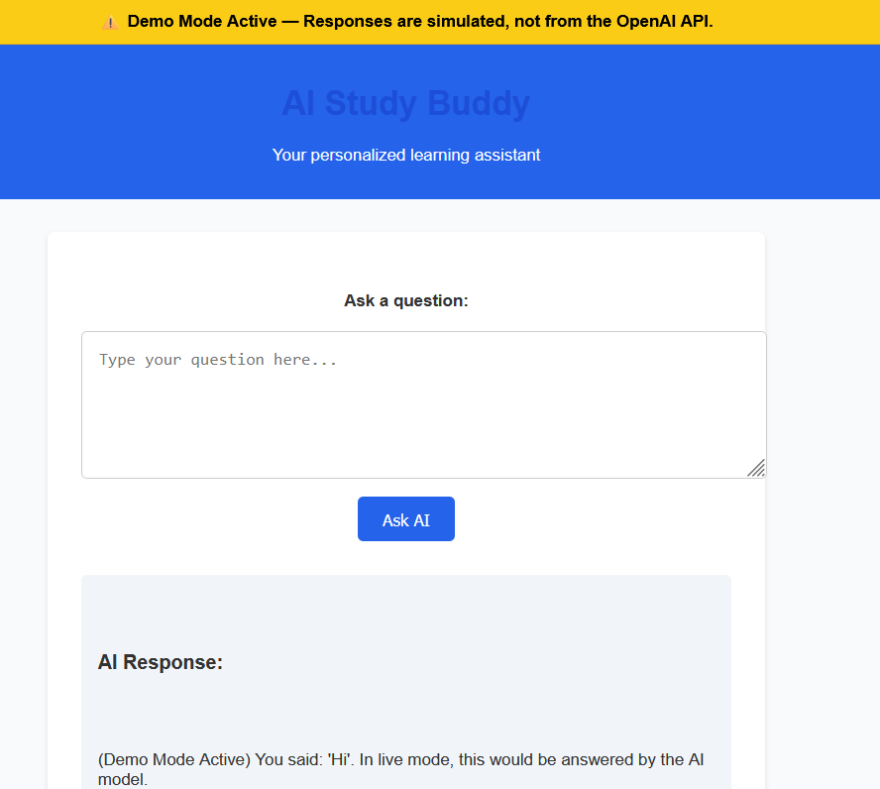
OPENAI API Version

Slide 17
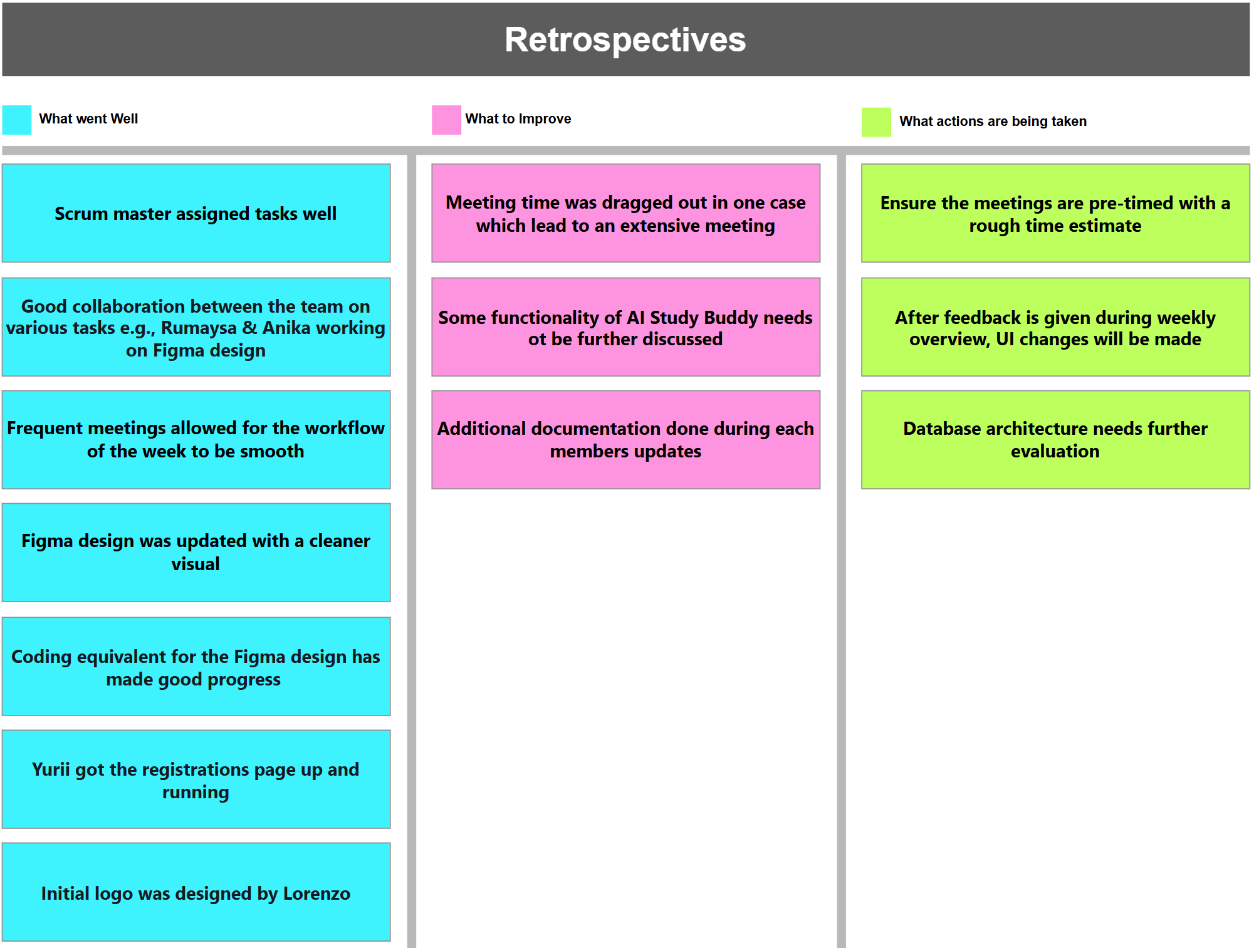

Slide 18
THANK YOU
Any Questions?

